Slide 1
COMPUTING IN CONTEXT
WILLIAM MONGAN
June 29, 2022

Slide 2
THINGS WE’LL NEED
A quarter
A deck of cards
A phone book
Printouts from these slides
Strips of paper
Post-it notes (labeled by color) and Poster Board, or the digital Pixel Pandemonium link
Mail-merged instruction sheets for post-it notes (or a link to a PDF)

Slide 3
ESTABLISHING TRUST
“IT IS AN EQUAL FAILING TO TRUST EVERYBODY, AND TO TRUST NOBODY. ” –ENGLISH PROVERB
“WHO DO I TRUST? ME!” -TONY MONTANA, SCARFACE

Slide 4
HOW DO WE ESTABLISH MUTUAL TRUST ON THE INTERNET?
Do you trust me? How can you be sure?

Slide 5
HOW DO WE ESTABLISH MUTUAL TRUST ON THE INTERNET?
Do you trust me? How can you be sure?
… Do I trust YOU?

Slide 6
HOW DO WE ESTABLISH MUTUAL TRUST ON THE INTERNET?
Do you trust me? How can you be sure?
… Do I trust YOU?
What happens when you need to trust someone, while also establishing that they can trust you?
What are some examples of this?

Slide 7
HOW DO WE ESTABLISH MUTUAL TRUST ON THE INTERNET?
Let’s flip a coin: how do you guess correctly when you can’t see me flip the coin?

Slide 8
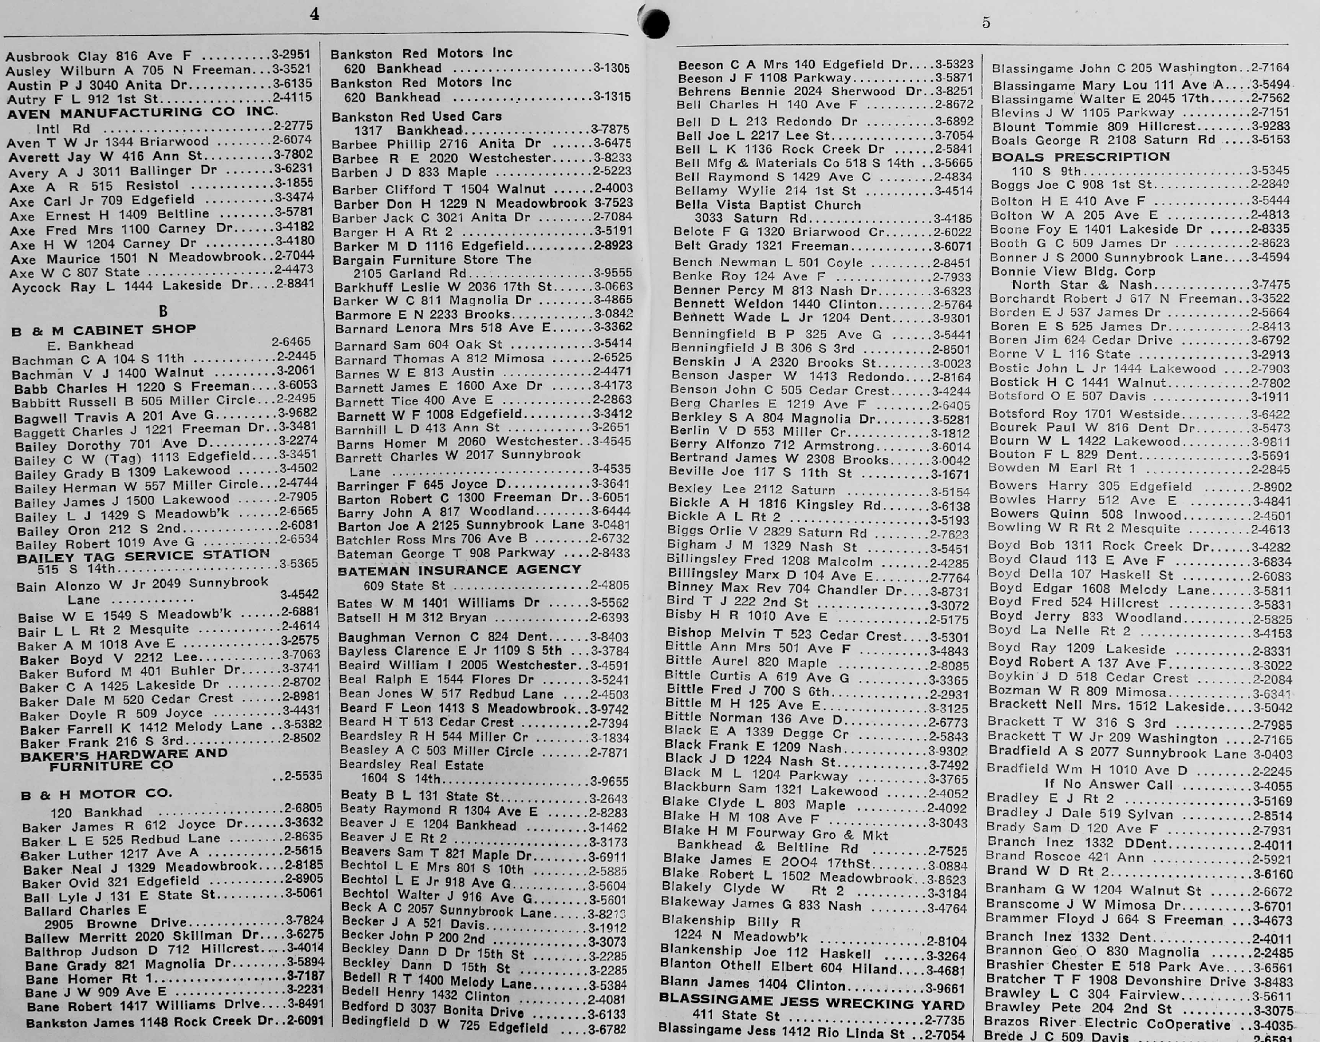
http://www.garland1965.com/garland1965/Photo_album/Memorabilia/Directories/PhoneFeb52/2009-06-04_143416_Steve_Rhodes.jpg

Slide 9
HOW DO WE ESTABLISH MUTUAL TRUST ON THE INTERNET?
Let’s flip a coin: how do you guess correctly when you can’t see me flip the coin?
One-Way Functions:
Give out a phone number corresponding to a name beginning with “H” or “T,” corresponding to the coin flip.
Take the guess from the other party.
Reveal the name corresponding with that phone number, and allow the other party to verify the name corresponding to the coin flip result.

Slide 10
ERROR CORRECTION
“POSITIVE, ADJ.: MISTAKEN AT THE TOP OF ONE’S VOICE.” - AMBROSE BIERCE, THE UNABRIDGED DEVIL’S DICTIONARY “BUT THE GAME NEVER ENDS WHEN YOUR WHOLE WORLD DEPENDS ON THE TURN OF A FRIENDLY CARD” - THE ALAN PARSONS PROJECT, THE TURN OF A FRIENDLY CARD

Slide 11
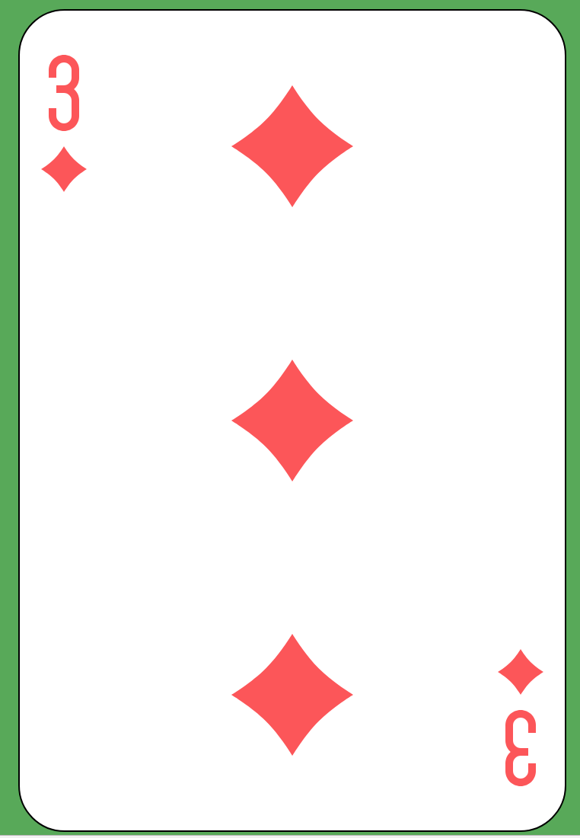

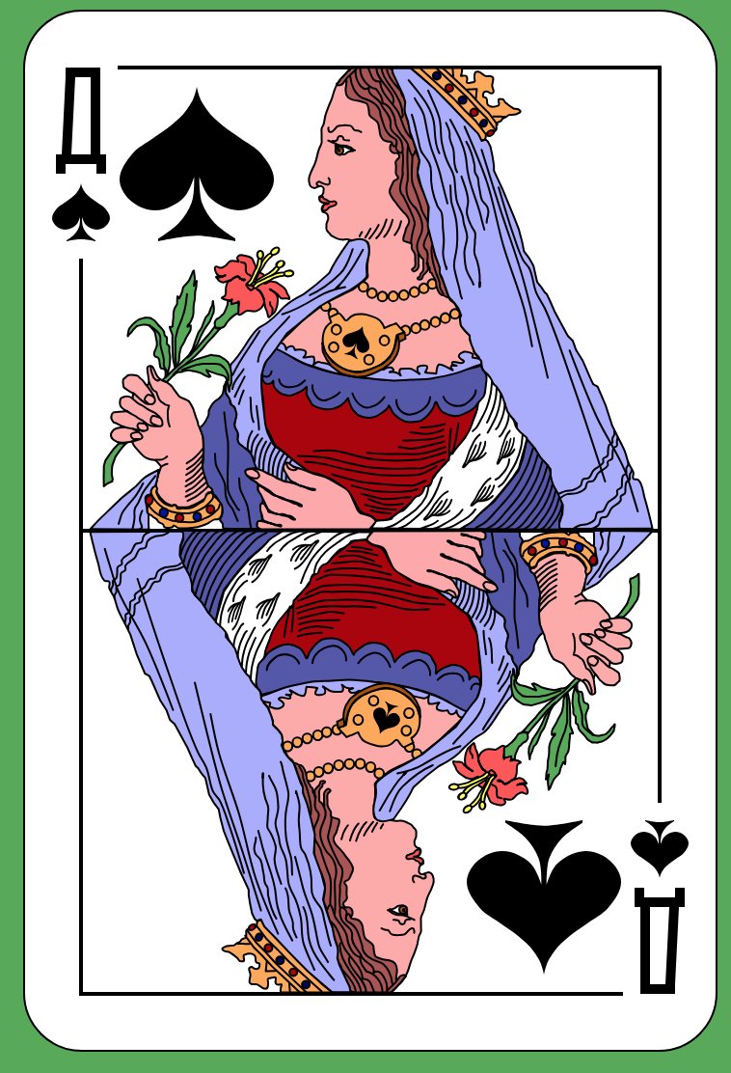
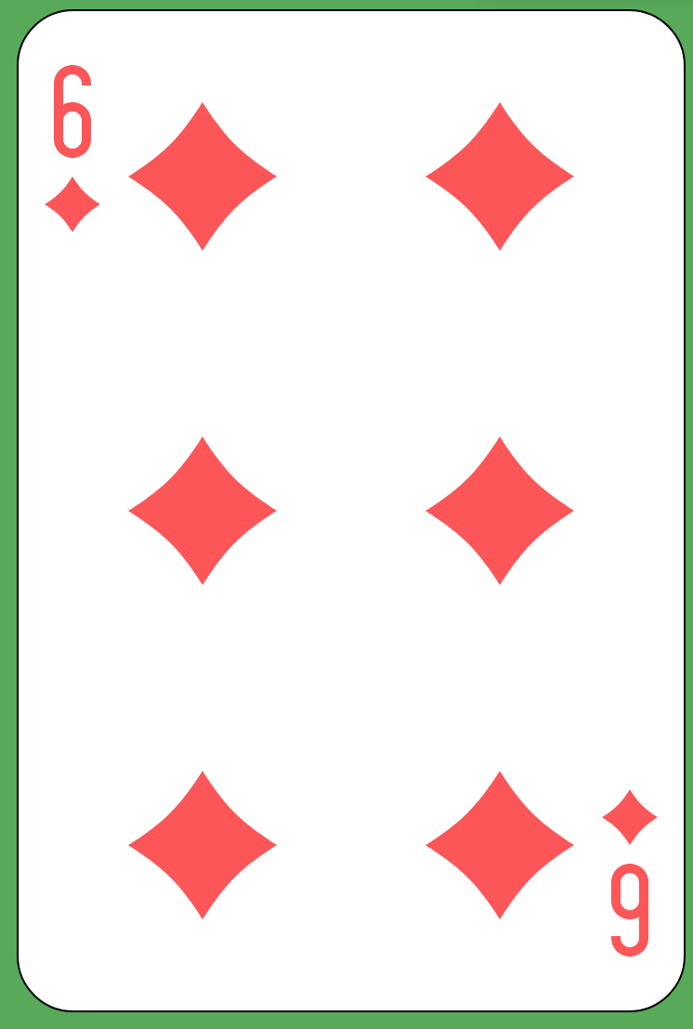
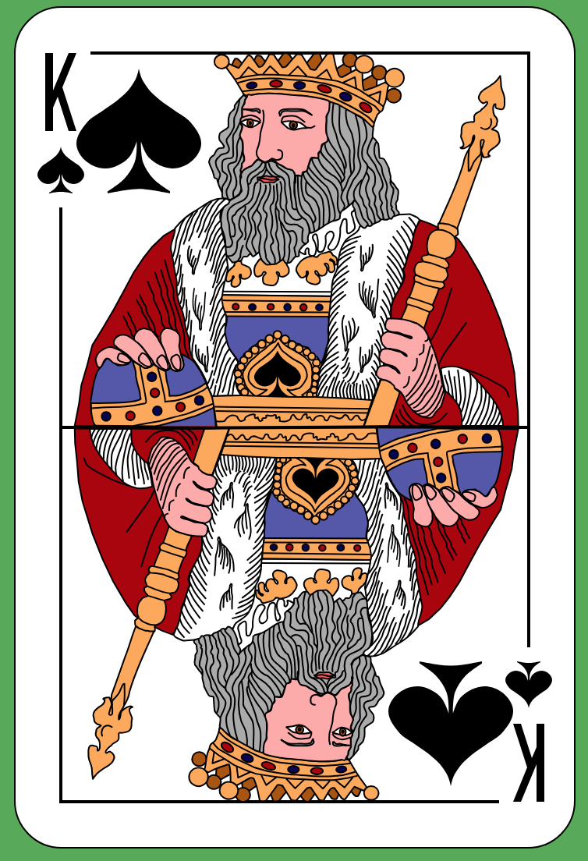
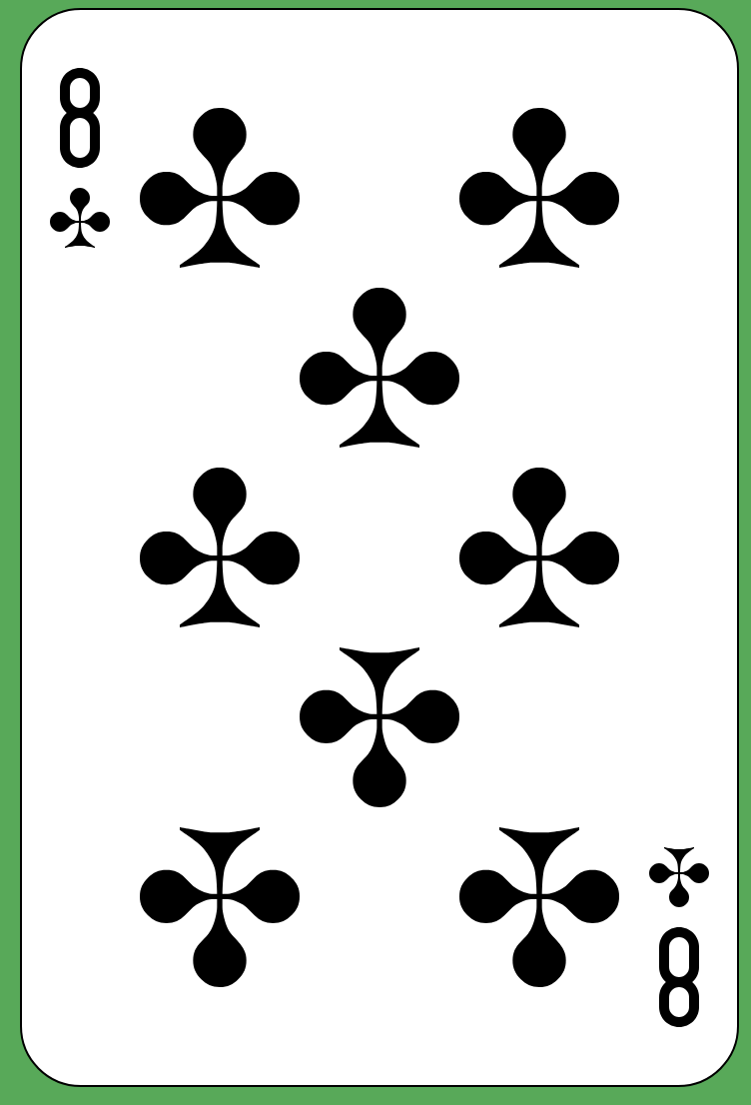

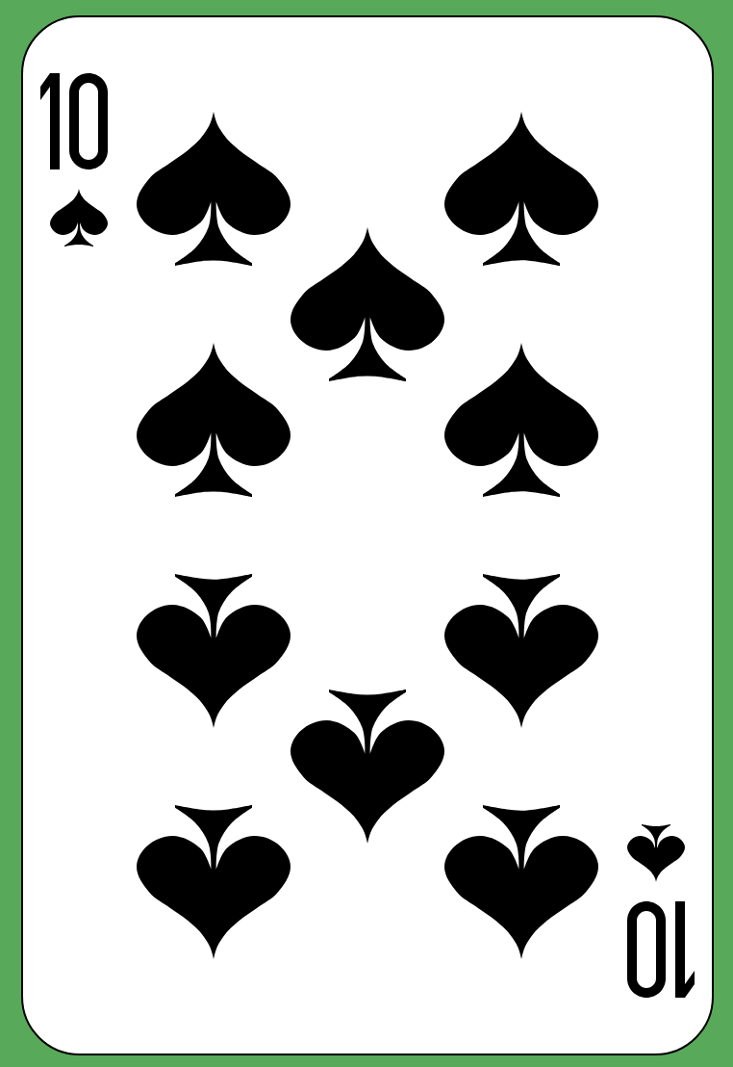
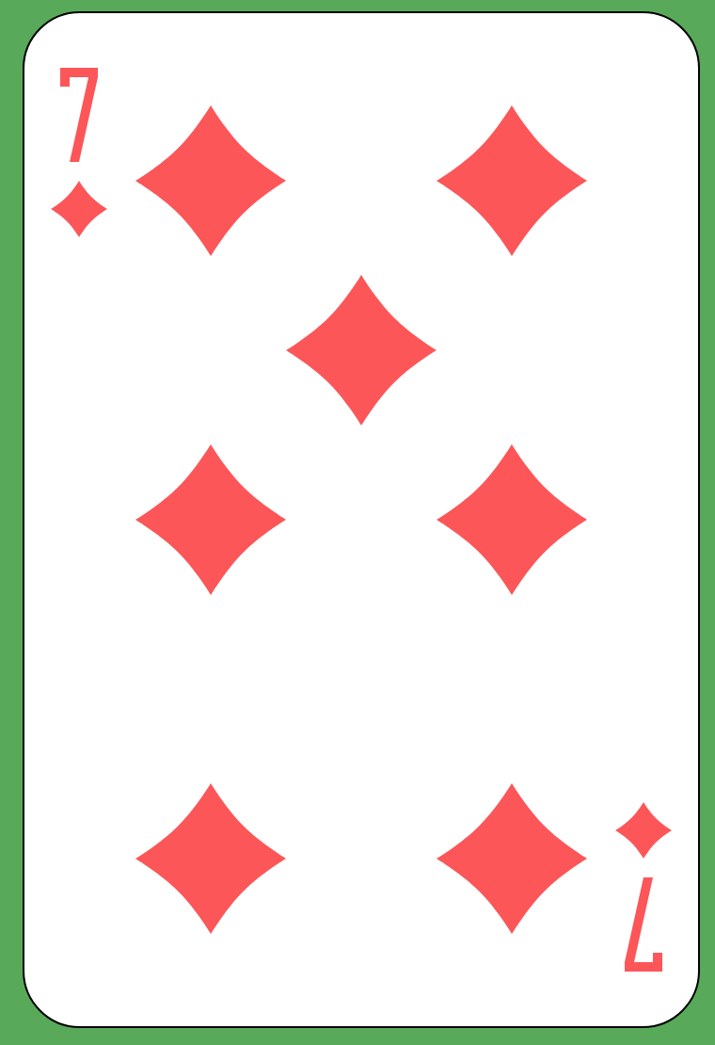


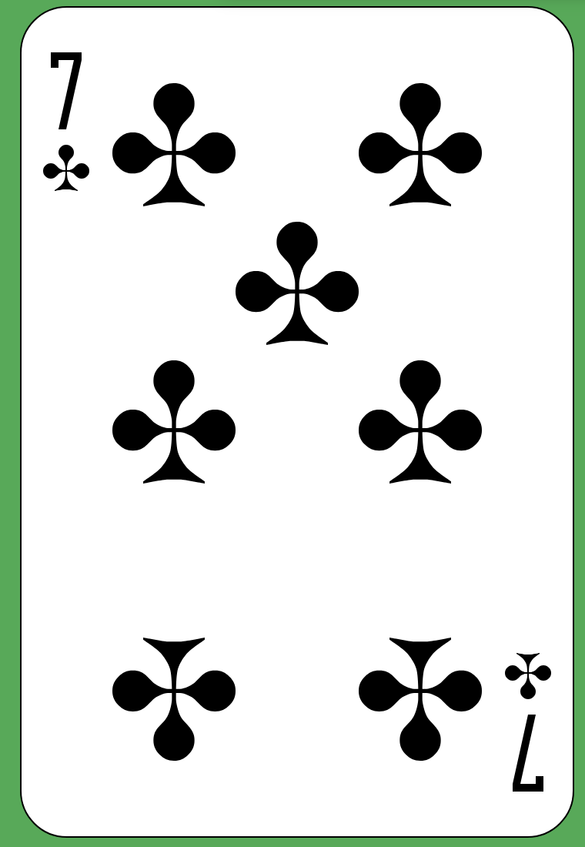

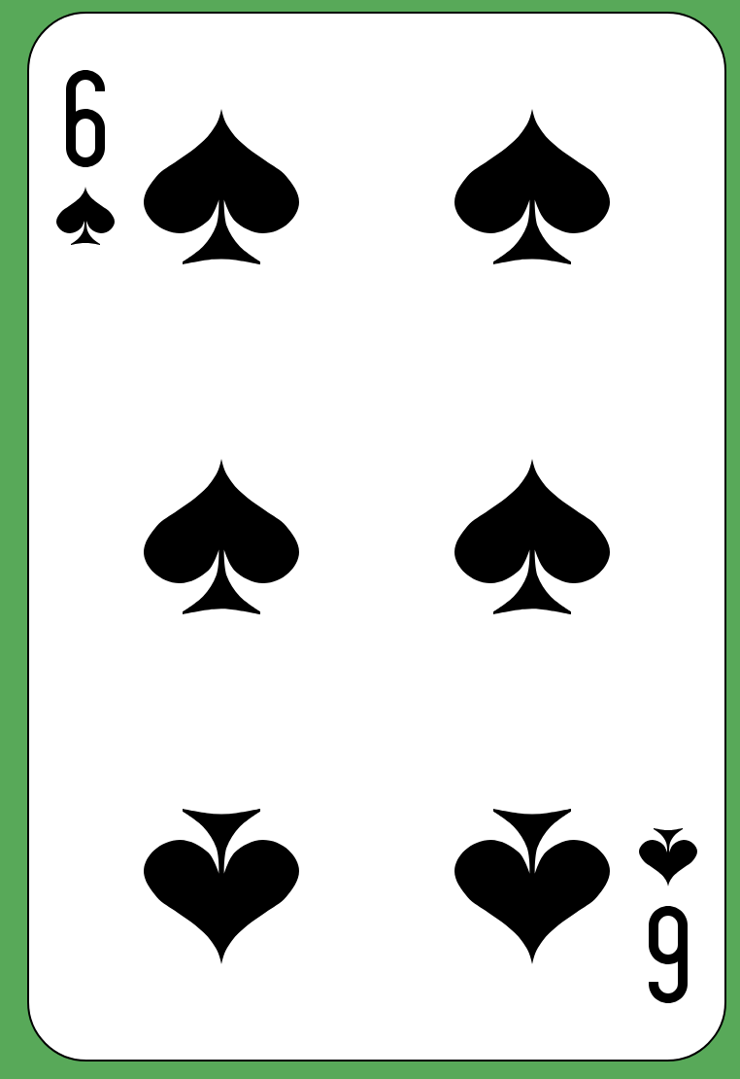
Deal out a 5x5 grid of cards with a random pattern of face-up and face-down cards, like this.
https://upload.wikimedia.org/wikipedia/commons/5/55/Atlasnye_playing_cards_deck.svg
https://publicdomainvectors.org/en/free-clipart/Grid-red-playing-card-vector-image/9068.html

Slide 12
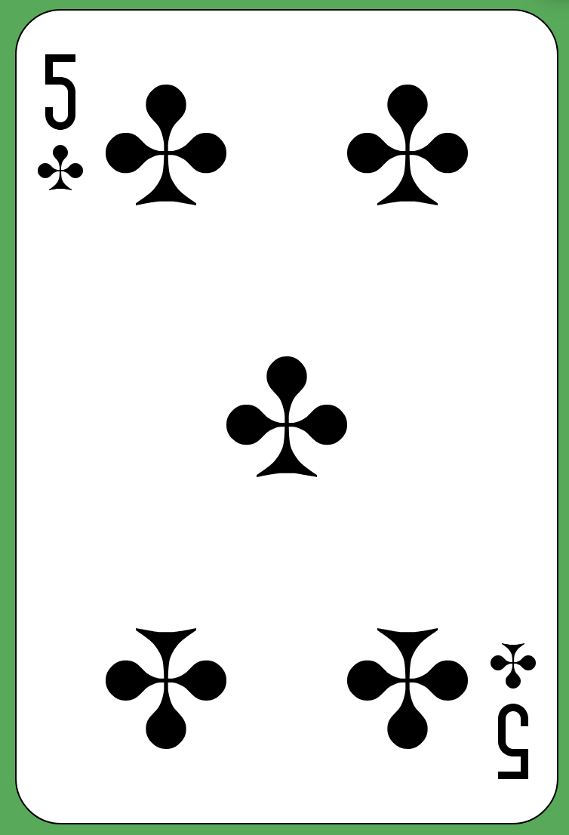

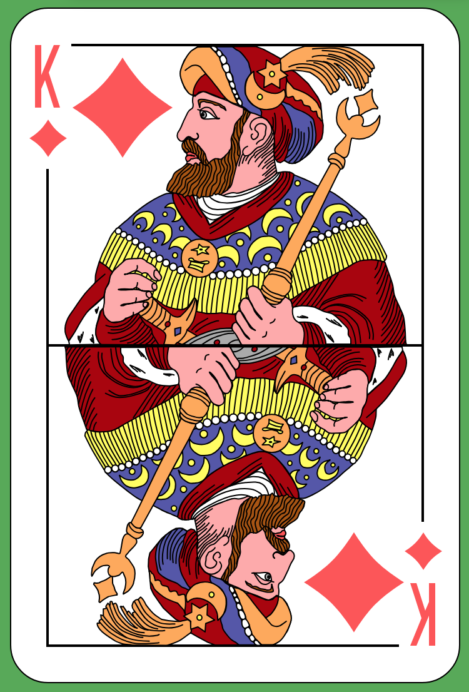
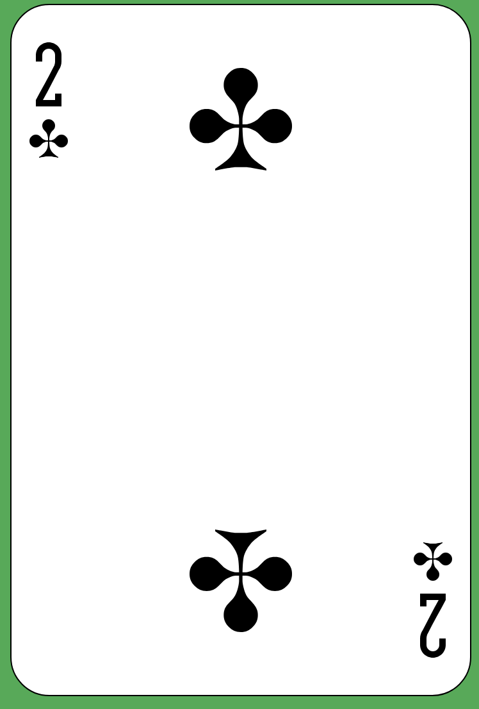
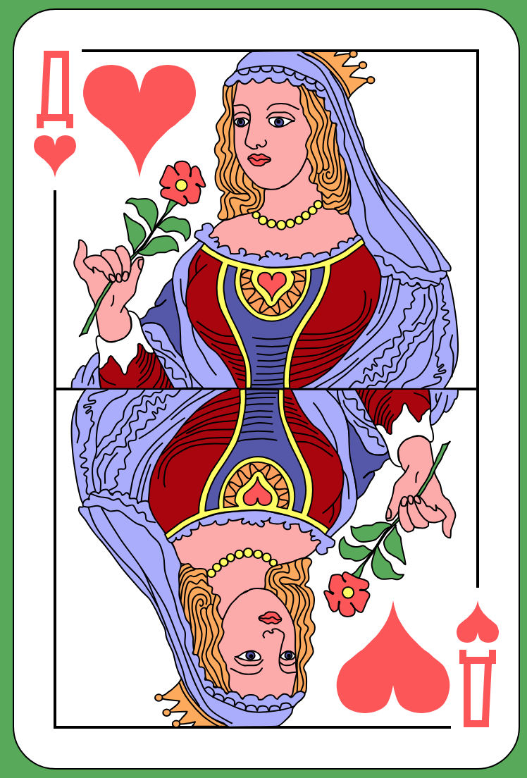
Deal out a 5x5 grid of cards with a random pattern of face-up and face-down cards, like this.
Now, we add an additional row and column to the grid…
Then, introduce an “error” into this “binary” code by flipping a card over (it doesn’t matter whether the card is face-up or face-down).

Slide 13
Deal out a 5x5 grid of cards with a random pattern of face-up and face-down cards, like this.
Now, we add an additional row and column to the grid…
Then, introduce an “error” into this “binary” code by flipping a card over (it doesn’t matter whether the card is face-up or face-down).
Which card?

Slide 14
Deal out a 5x5 grid of cards with a random pattern of face-up and face-down cards, like this.
Now, we add an additional row and column to the grid…
Then, introduce an “error” into this “binary” code by flipping a card over (it doesn’t matter whether the card is face-up or face-down).
Which card?
What was special about the “extra” row and column?
Does this always work?

Slide 15
Deal out a 5x5 grid of cards with a random pattern of face-up and face-down cards, like this.
Now, we add an additional row and column to the grid…
Then, introduce an “error” into this “binary” code by flipping a card over (it doesn’t matter whether the card is face-up or face-down).
Which card?
What was special about the “extra” row and column?
Parity: The number of face up cards is always a multiple of 2
Does this always work?
If you flip multiple cards in the same row, you might miss it

Slide 16
TAKE OUT A CREDIT CARD!
“…LEND IT RATHER TO THINE ENEMY, WHO, IF HE BREAK, THOU MAYST WITH BETTER FACE EXACT THE PENALTY.” - ANTONIO, SHAKESPEARE’S MERCHANT OF VENICE

Slide 17
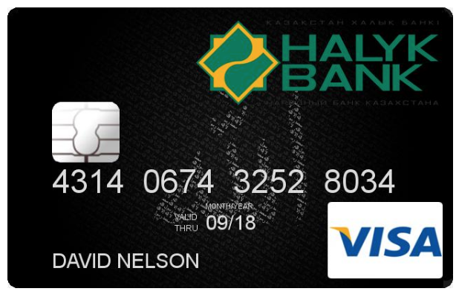
CHECKSUM ERROR DETECTION: CREDIT CARD CHECK-10
Given a credit card number (4314 0675 3252 8034)
Double every other digit, skipping the last one (starting with the second digit)
4618 0(12)78 3454 803X
http://card-generator.com/q_credit-card-picture-generator.htm

Slide 18
CHECKSUM ERROR DETECTION: CREDIT CARD CHECK-10
Given a credit card number (4314 0675 3252 8034)
Double every other digit, skipping the last one (starting with the second digit)
4618 0(12)78 3454 803X
Add all those digits together
4+6+1+8+0+1+2+7+8+3+4+5+4+8+0+3 = 64
http://card-generator.com/q_credit-card-picture-generator.htm

Slide 19
CHECKSUM ERROR DETECTION: CREDIT CARD CHECK-10
Given a credit card number (4314 0675 3252 8034)
Double every other digit, skipping the last one (starting with the second digit)
4618 0(12)78 3454 803X
Add all those digits together
4+6+1+8+0+1+2+7+8+3+4+5+4+8+0+3 = 64
The last digit (4) is the “check 10” digit:
64 mod 10 = 4
http://card-generator.com/q_credit-card-picture-generator.htm

Slide 20
PUBLIC KEY CRYPTOGRAPHY
”FEW FALSE IDEAS HAVE MORE FIRMLY GRIPPED THE MINDS OF SO MANY INTELLIGENT MEN THAN THE ONE THAT, IF THEY JUST TRIED, THEY COULD INVENT A CIPHER THAT NO ONE COULD BREAK.” – DAVID KAHN, THE CODEBREAKERS: THE STORY OF SECRET WRITING

Slide 21
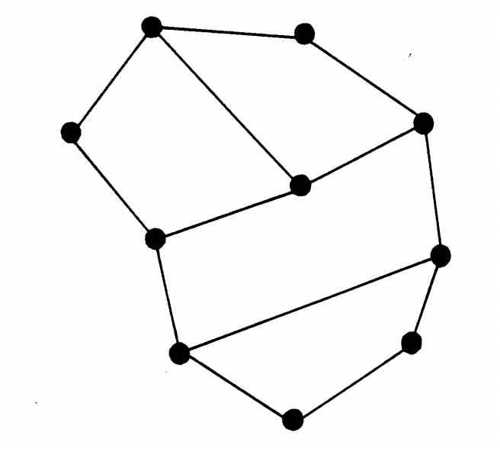
CRYPTOGRAPHY AS DIFFICULT-TO-REVERSE FUNCTIONS / NONDETERMINISTICALLY POLYNOMIAL ALGORITHMS
Our partner gives us the graph on the left.
Choose a number that we want to send ”secretly” to our partner.
Let’s say 100.
Break up the number 100 into 10 numbers that sum to 100.
We use 10 numbers because there are 10 vertices on this graph.
https://classic.csunplugged.org/wp-content/uploads/2014/12/unplugged-18-public_key_encryption_0.pdf

Slide 22
CRYPTOGRAPHY AS DIFFICULT-TO-REVERSE FUNCTIONS / NONDETERMINISTICALLY POLYNOMIAL ALGORITHMS
Our partner gives us the graph on the left.
Choose a number that we want to send ”secretly” to our partner.
Let’s say 100.
Break up the number 100 into 10 numbers that sum to 100.
We use 10 numbers because there are 10 vertices on this graph.
14
11
8
5
7
12
18
6
4
15
https://classic.csunplugged.org/wp-content/uploads/2014/12/unplugged-18-public_key_encryption_0.pdf

Slide 23
CRYPTOGRAPHY AS DIFFICULT-TO-REVERSE FUNCTIONS / NONDETERMINISTICALLY POLYNOMIAL ALGORITHMS
Our partner gives us the graph on the left.
Choose a number that we want to send ”secretly” to our partner.
Let’s say 100.
Break up the number 100 into 10 numbers that sum to 100.
We use 10 numbers because there are 10 vertices on this graph.
Now, replace each vertex with the sum of itself plus all neighboring vertices.
14
11
40
30
8
34
41
38
5
33
7
12
33
18
51
6
37
25
4
15
https://classic.csunplugged.org/wp-content/uploads/2014/12/unplugged-18-public_key_encryption_0.pdf

Slide 24
CRYPTOGRAPHY AS DIFFICULT-TO-REVERSE FUNCTIONS / NONDETERMINISTICALLY POLYNOMIAL ALGORITHMS
Our partner gives us the graph on the left.
Choose a number that we want to send ”secretly” to our partner.
Let’s say 100.
Break up the number 100 into 10 numbers that sum to 100.
We use 10 numbers because there are 10 vertices on this graph.
Now, replace each vertex with the sum of itself plus all neighboring vertices.
Remove the original values.
40
30
34
41
38
33
33
51
37
25
https://classic.csunplugged.org/wp-content/uploads/2014/12/unplugged-18-public_key_encryption_0.pdf

Slide 25
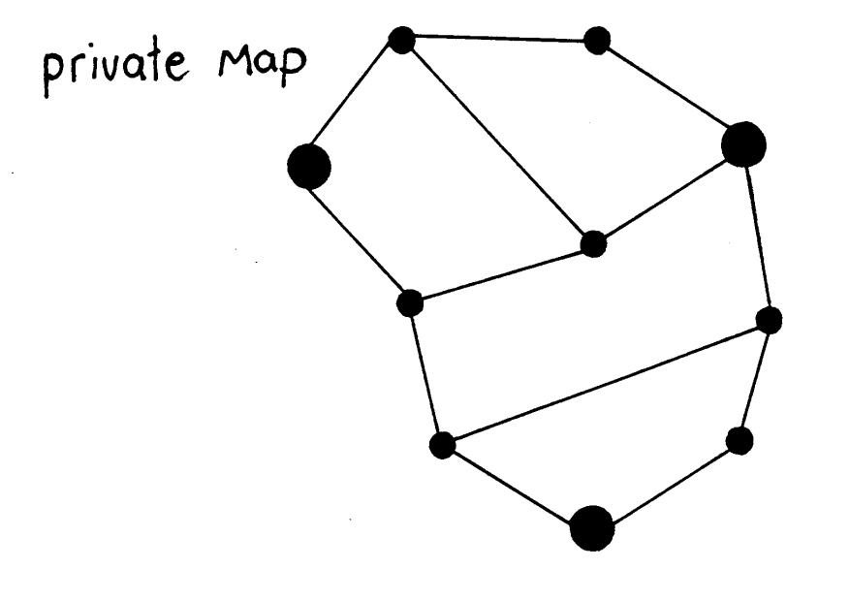
CRYPTOGRAPHY AS DIFFICULT-TO-REVERSE FUNCTIONS / NONDETERMINISTICALLY POLYNOMIAL ALGORITHMS
The three vertices highlighted in bold will sum to 100.
They form the solution to the vertex-cover problem, an NP-Complete problem that can only be solved by brute force or approximation, unless we learn that P=NP and that a polynomial-time solution is possible.
So, it’s a very hard problem to solve for large graphs, for the moment.
… but not so hard to create!
40
30
34
41
38
33
33
51
37
25
https://classic.csunplugged.org/wp-content/uploads/2014/12/unplugged-18-public_key_encryption_0.pdf

Slide 26
CRYPTOGRAPHY AS DIFFICULT-TO-REVERSE FUNCTIONS / NONDETERMINISTICALLY POLYNOMIAL ALGORITHMS
Typically, one encrypts a message using someone’s public key. Only the person with the private key can decrypt that message, while others “cannot” even in possession of the public key.
When might one encrypt with their own private key for decryption by all with the public key?
What can you be sure of?
40
30
34
41
38
33
33
51
37
25
https://classic.csunplugged.org/wp-content/uploads/2014/12/unplugged-18-public_key_encryption_0.pdf

Slide 27
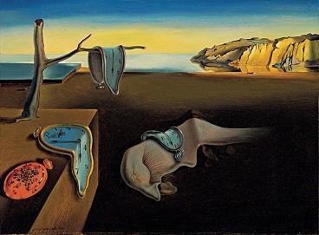
DIGITAL REPRESENTATION OF COMPUTER GRAPHICS
SALVADOR DALÍ, THE PERSISTENCE OF MEMORY
https://upload.wikimedia.org/wikipedia/en/d/dd/The_Persistence_of_Memory.jpg

Slide 28
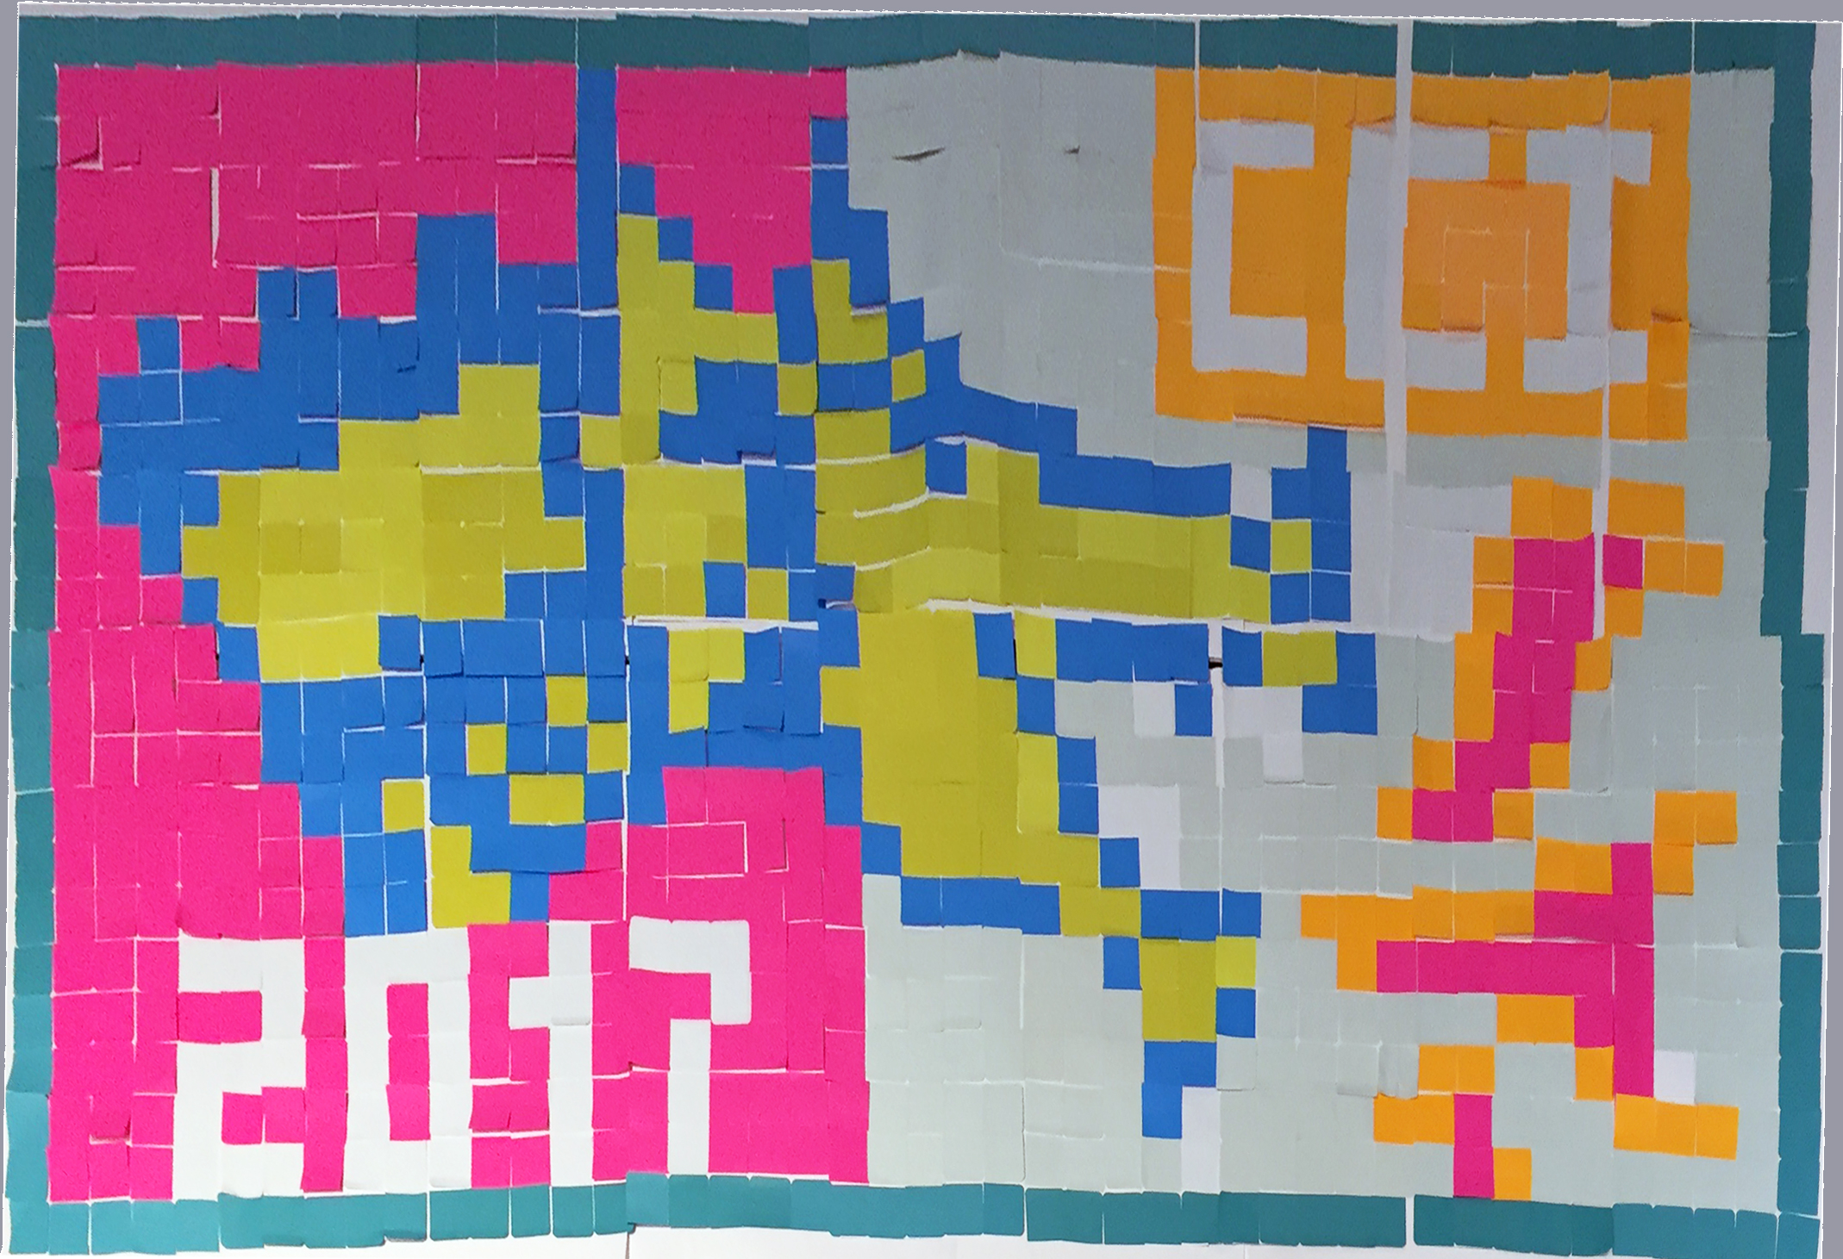
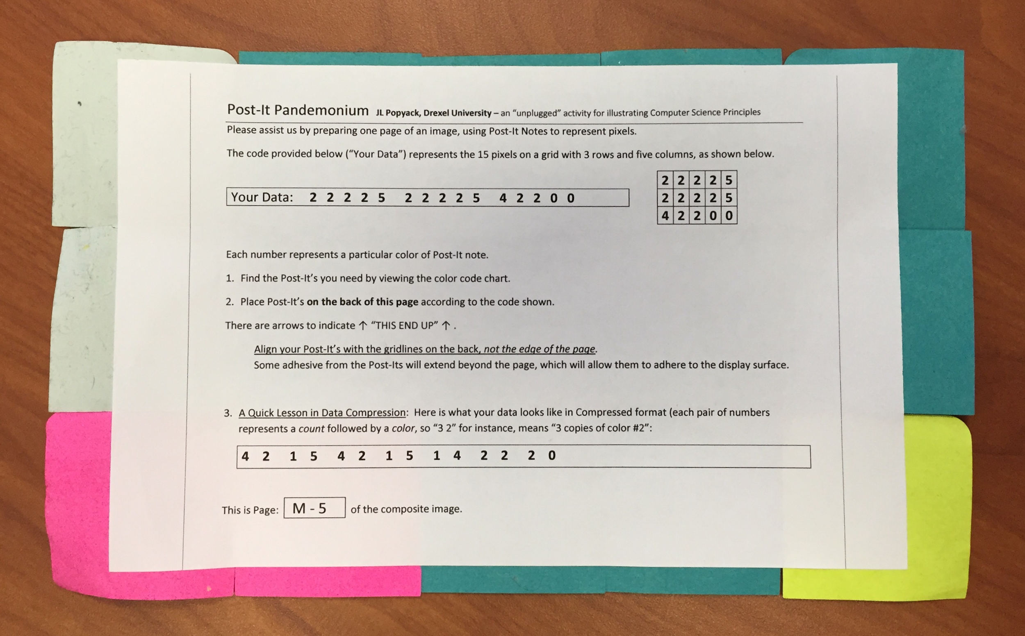
PIXELS, POST-ITS, AND CS PRINCIPLES
Jeff Popyack developed a fun and engaging unplugged activity of his own, demonstrating image representation and compression.
https://www.billmongan.com/Ursinus-CS173/DrawingCanvas
https://tinyurl.com/MonganPostIt
https://www.cs.drexel.edu/~jpopyack/Post-It/index.html

Slide 29
SO WHAT?
“I BELIEVE THAT EVERYTHING HAPPENS FOR A REASON.” - MARILYN MONROE

Slide 30
SO WHAT?
Computer Science, like STEM, is not a “subject.” It is a mindset that permeates other disciplines and our society.
It’s not “programming” – rather, it is something that people develop and use collaboratively to solve practical problems in society.
You don’t need a computer to do computer science – the foundational principles at the intersection of STEM make computers possible.
… and anyone can learn about them.
These are a few examples I’ve adapted or used from others to develop inter-relating ideas – they are conversation starters to provide context to the underlying mathematics and theory that follows.

Slide 31
DESCRIPTION
This class will explore and demonstrate applied learning methods for introducing Computer Science principles, focusing on putting those principles into relatable contexts. We will conduct group activities and experiments that reveal that computer science is a mindset that permeates society and solves big problems in ways that computers can be built to exploit. We will then apply these principles using programming in the Python language and using micro:bit devices. Students will be encouraged to propose and complete a small "hackathon" project with their classmates, to be presented on the last day.

